Slide 1
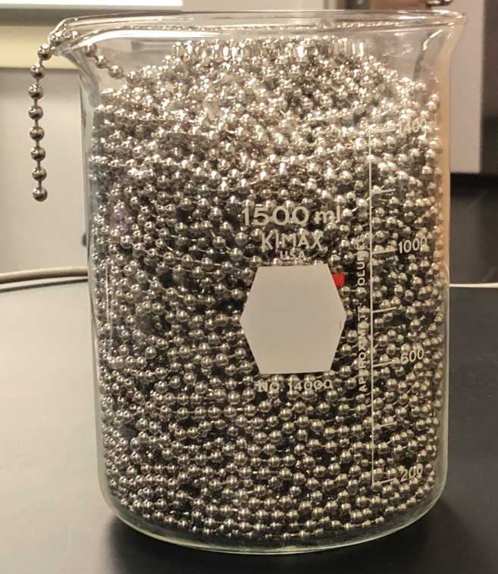
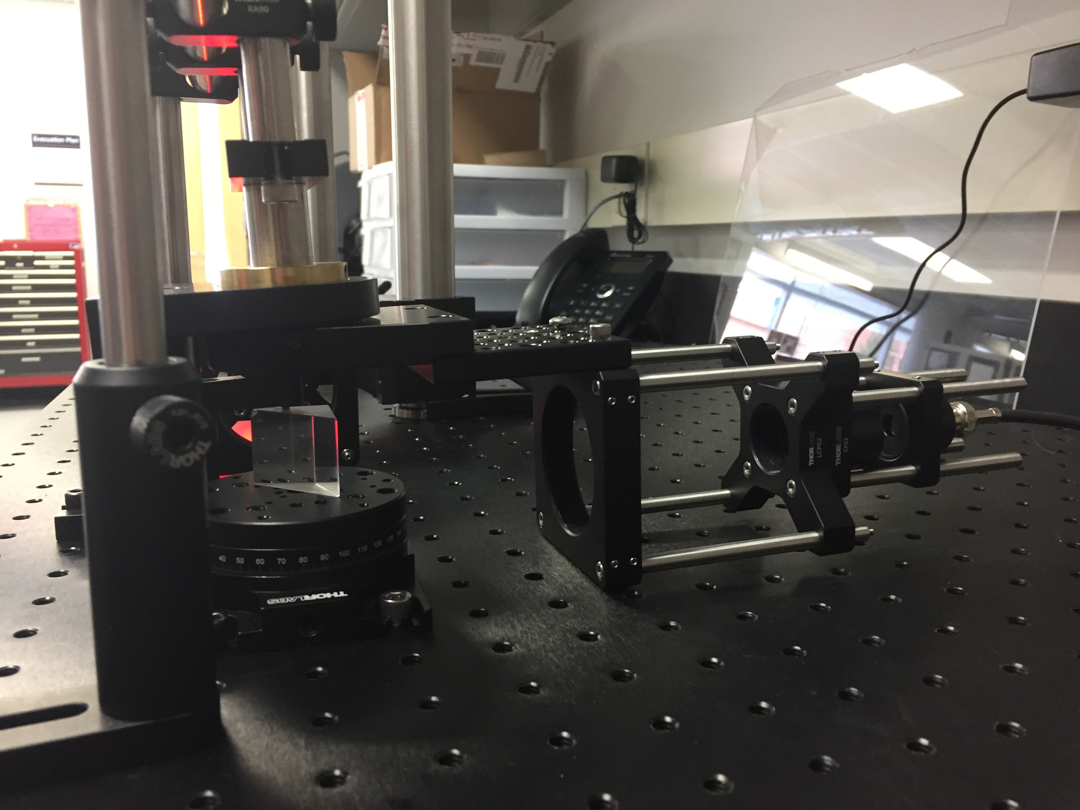
Additionally, each group presented a poster at the university STEM Expo. This poster went through two drafts, with feedback from the instructor at each stage.
At the end of the semester the group wrote a paper summarizing their experiment to act as a manual for the next group of students to take the class. This paper also went through two drafts.
In addition to one lecture period devoted to ethical behavior in science research, ethics was also included explicitly when discussing keeping lab notebooks, when working on as part of a team, and reporting of results.
Introduction
Graded assignments included lab notebook checks, several short oral reports, a poster, a paper, and a final group oral report.
The first week of class was spent discussing use of lab notebooks, data plotting, and how to be an effective member of a team. Students also indicated their preferences for choice of experiment based on what skills they already have and what skills they would like to develop.
Students where assigned to one of five research groups, with one advanced student working with one or two introductory students. Each research group worked on one project for the entire semester. Since this was the first offering of the course, many of the
A new Advanced Physics Lab course was developed to give students experience will soft skills, such as leadership and mentoring, working in teams, scientific ethics, and communication skills along with the traditional experimental skills. The advanced lab course was offered in conjunction with a freshman level Introduction to Research Methods in Physics course. This combination of two different levels of students was done to populate a traditionally low-enrolled upper-division course, to provide senior students with leadership experience, and to provide freshmen an authentic research experience. The intro-level course has no physics prerequisite and counted as a general education science credit so it was open to students of all disciplines. Students were formed into teams of two to three students with a senior student as the team leader.
The introductory course focused on basic scientific research methods, keeping lab notebooks, working as a member of a team, scientific ethics, and scientific communication. The advanced lab course focused on team leadership, experimental design, and more advanced data analysis and scientific communication, along side the traditional experimental skills.
experiments started off in very embryonic states, which made it easy for students to expand the experiments. Experiments included saturation absorption spectroscopy of rubidium, characterization of plasma-created nanoparticles, stabilization of a HeNe laser, surface plasmon resonance in thin films, and exploration of a chain fountain.
“[This class] has made me more confident with scientific research. I was not sure how to structure an experiment before taking this class. “
Experimental Design – Big and Little Questions
Students where introduced to the idea of asking “big questions” and “little questions”. A big question is answered over the course of the semester and is their main goal. A little question is something that can be answered on a shorter timescale and typically involves one to several experiments. At the start of each class
“This class is very helpful for teaching group dynamics, most projects in other classes are not nearly as long. For freshman, its very good and should almost be required, for seniors, it is also good but noticeably less so”
period, each team would discuss the little questions they were working on, how they moved them towards answering the big question, and any new little questions that had come up or still needed to be answered.
“I did not like physics before I took this class. I was never very good at it and I was thinking it was going to be really hard. But now I love this class and I feel like I know what I am doing and how my skills relate to our experiment. “
Teamwork
“This lab teaches tenacious thinking and the ability to completely rework a setup that doesn't work”
Course Goals
Two lecture class periods were spent on teamwork (for the intro class) or leadership (for the advanced class). At the end of each week the group would come together to answer the questions “what is an example of something you did this week that shows good teamwork” and “what can you do next week to improve your ability to work as a team”.
The advanced students would spend the first few minutes of the weekly lecture section discussing successes or issues that came up in their group and discussed how to improve their group performance.
Course Goals for Introduction to Research Methods in Physics:
A student who has successfully completed this course will be able to:
1.Explain the purposes and goals of experiments.
2.Design an experiment to test a hypothesis
3.Analyze data and report relevant information
4.Communicate scientific information orally and in writing
5.Work effectively in a team
Course Goals for Advanced Physics Lab:
A student who has successfully completed this course will be able to:
1.Use typical experimental physics equipment
2.Design an experiment to test a hypothesis
3.Analyze data and report relevant information
4.Communicate scientific information verbally and in writing
5.Read research articles
6.Lead a team of researchers
Results and Future Directions
Out of thirteen respondents, eleven would recommend the class to a friend while the remaining two stated they did not recommend classes that aren’t required. Student feedback on the skills learned in the course include the following topics: Four out of six students in the upper-level course mention developing leadership skills while four out of seven students from the introductory course mention learning better teamwork skills. Two out of thirteen students mention improved communication skills and two out of thirteen mention improved critical thinking skills as a result of the course. All quotes in this poster are from students in the course.
Based on student feedback, future courses will include more information on data analysis, more guidance on how to write a good research paper, and learning how to 3D print parts for the experiments. Since one of the objectives is for each group of students to improve upon the experiments, future groups will start with the paper written during the first offering of the courses and build upon what has already been done. Case studies for the section on ethics will be developed from the existing readings.
“[This class] made me realize that working in a team can be beneficial if the team leader has an idea of the direction they want to go and if the teammates are motivated. “
Communication Skills
The laboratory notebook is one of the researchers most powerful tools. Yet interviews with scientific researchers tell of no formal training in the use of laboratory notebooks[1] and what training students receive is ineffective[2]. In order to encourage student ownership of the projects[3], the first week of class was spent discussing the importance of lab notebooks and developing a rubric for notebooks as a class[4]. Electronic notebooks[5] where used in order to allow team members to see one another work and for team leaders to give feedback to their team members. At various intervals the instructor gave feedback to students in both classes, while team leaders would give feedback to team members at other times.
Each week one team member from each team would give a 5-minute presentation to the entire class on the state of their experiment. All students and the instructor provided written feedback on each presentation. The entire team gave a 20-minute presentation on their experiment at the end of the semester.
“[This class] made me realize how much of a collaborative effort real research can be, as well as how time-consuming it can be.”
References
Course Structure
[1] Stanley, J. T., & Lewandowski, H. J. (2016). Lab notebooks as scientific communication: Investigating development from undergraduate courses to graduate research. /Phys. Rev. Phys. Educ. Res./, /12/(2), 020129–11. http://doi.org/10.1103/PhysRevPhysEducRes.12.020129
[2]Stanley, J. T., & Lewandowski, H. J. (2018). Recommendations for the use of notebooks in upper-division physics lab courses. /American Journal of Physics/, /86/(1), 45–53. http://doi.org/10.1119/1.5001933
[3] Stanley, J. T., Dounas-Frazer, D. R., Kiepura, L., & Lewandowski, H. J. (2016). Investigating student ownership of projects in an upper-division physics lab course (pp. 336–339). Presented at the 2016 Physics Education Research Conference, American Association of Physics Teachers. http://doi.org/10.1119/perc.2016.pr.079
[4] Atkins, L. J., Proceedings, I. S. A. C., 2013. (n.d.). Using scientists’ notebooks to foster authentic scientific practices. /Aip.Scitation.org/
[5] Eblen-Zayas, M. (2015). Comparing Electronic and Traditional Lab Notebooks in the Advanced Lab (pp. 28–31). Presented at the 2015 Conference on Laboratory Instruction Beyond the First Year, American Association of Physics Teachers. http://doi.org/10.1119/bfy.2015.pr.007
Both courses had two 3-hour lab sessions that met together and a separate 1-hour lecture session for each course each week. This initial offering of the course had 6 students in the advanced course and 8 students in the introductory course. Although most of the students were physical science majors, two students were math majors and one student was an interior design student.

